Slide 1
Dorm Supplies
Management System
Cassandra Dawson, Colin Boykin, Prisha Satish

Slide 2
Our Team
Team Head
Cassandra
Colin
Prisha
Senior
Major: Games
Junior
Major: Computer Science
Sophomore
Major: Computer Science
02

Slide 3
TABLE OF CONTENTS
01
02
03
04
System
Description
ER
Model
EER
Model
SQL
Development
05
06
07
08
Loading Data &
Performance
User
Interface
Security
Measurements
Database
Integrity
03

Slide 4


System Description
Project Objective:
Design and implement a comprehensive database system for managing dorm-related supplies and student orders. This project transforms theoretical database models into a working SQL implementation that tracks students, dorm rooms, suppliers, items, and orders in a fully integrated system.
Key Features:
Student account management and authentication
Order processing, status tracking, and payment history
Dorm building and room assignment tracking
Comprehensive item catalog with categories (bed, bath, kitchen)
Supplier management with multiple location support
04

Slide 5
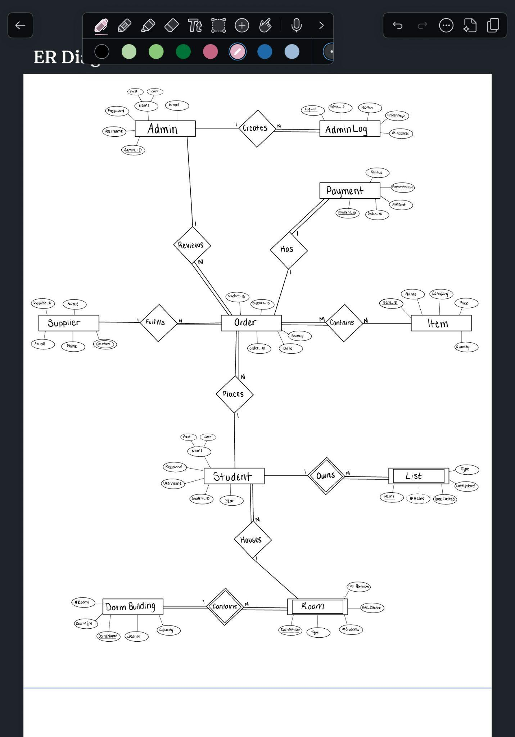
ER Model
05

Slide 6
ER Model Continued…
06

Slide 7
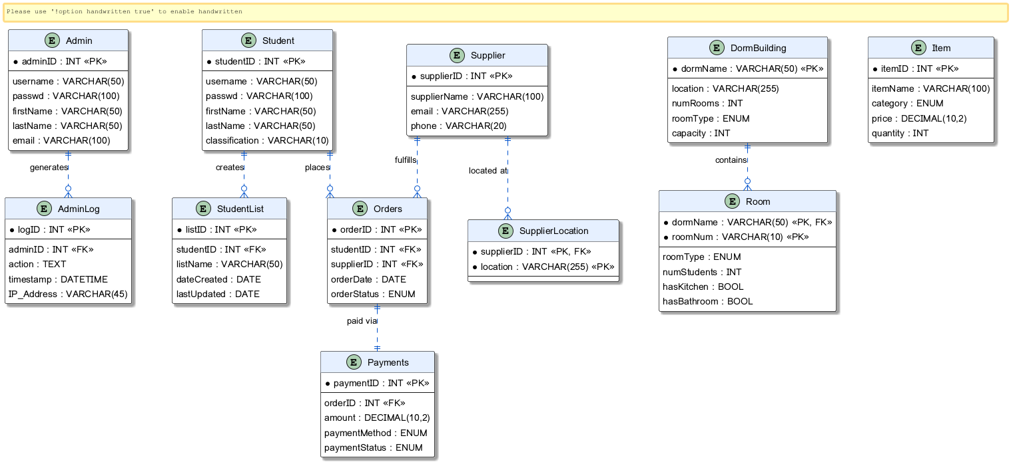
EER Model
07

Slide 8
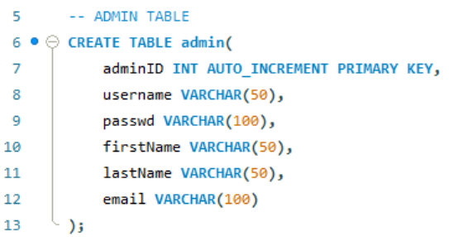
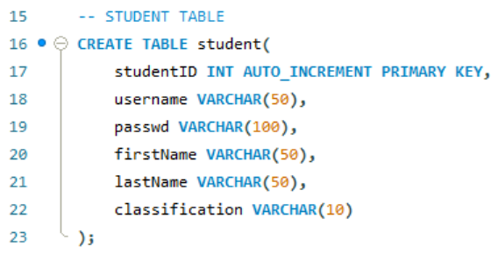
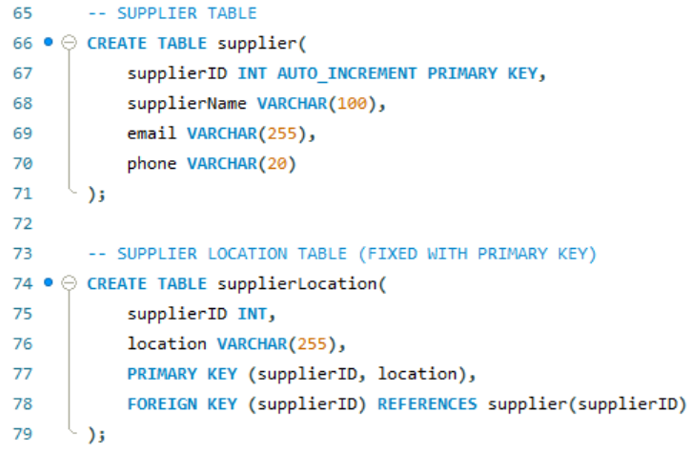
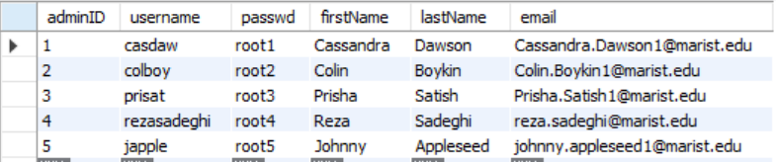
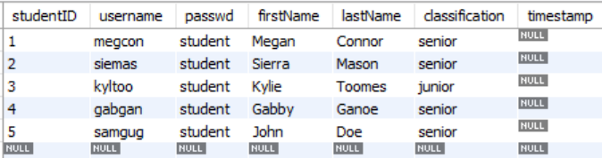
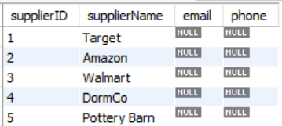
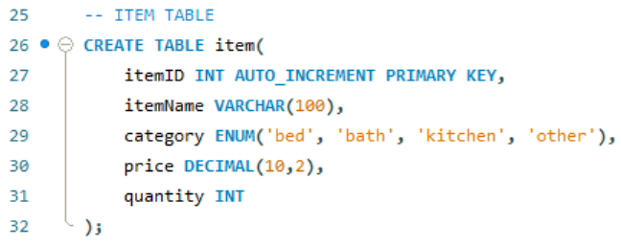
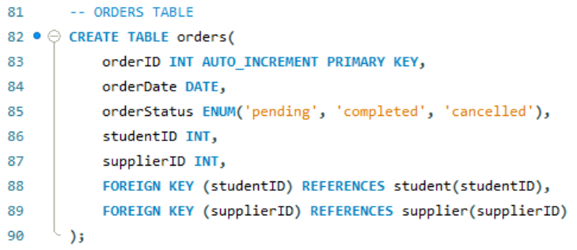
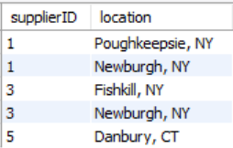
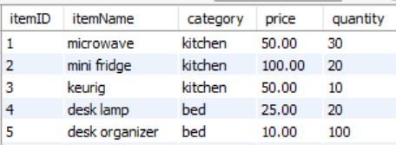
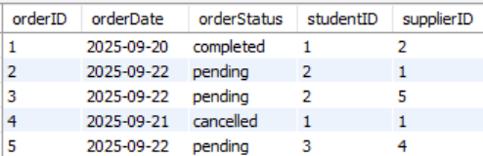
SQL Development : Tables
08

Slide 9
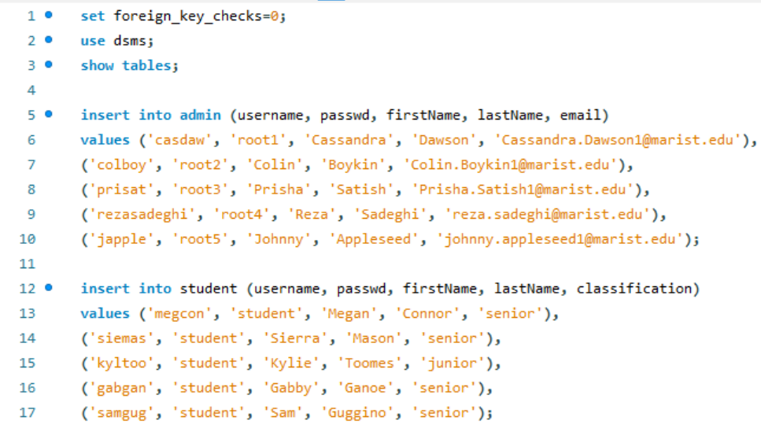
Loading Data
Importing Data
Disable foreign key checks
09

Slide 10

Performance Enhancements
Normalization
1NF
Multi-valued supplier location separated into separate table
Every table has unique primary key
2NF
Primary composite keys have non-key attributes depending on entire key
3NF
Fixed issue of no primary key in supplier location table
No non-key attributes depend on non-key attributes
10

Slide 11
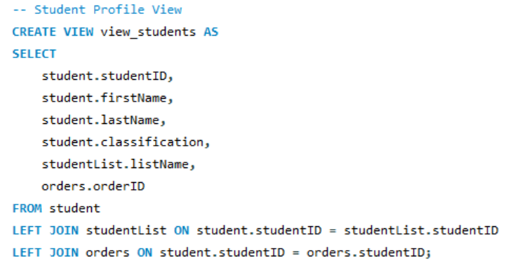
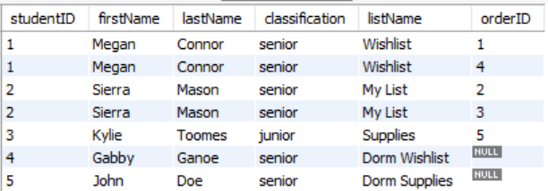
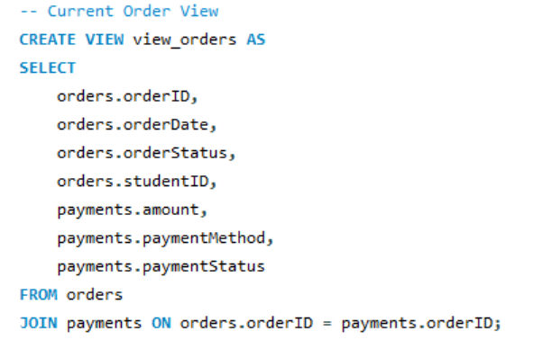
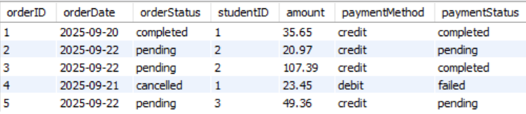
UI : Views
Student
Profile
Current
Order
11

Slide 12
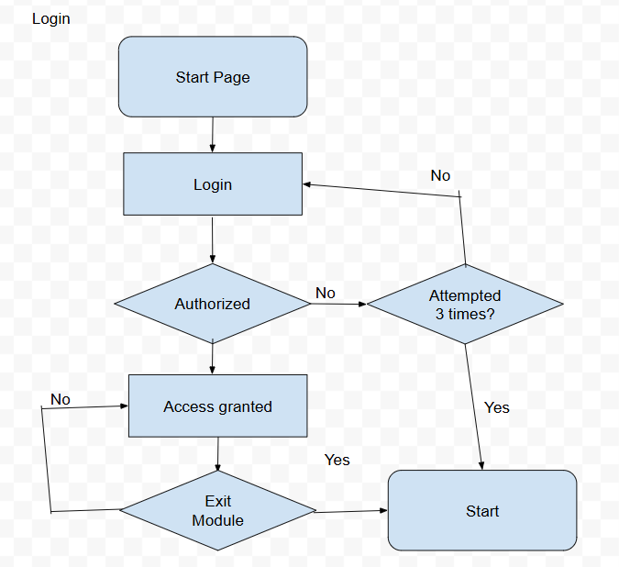
UI : Views Cont.
Other Pages:
Login
Main Page
Item Details
Order Tracking
List View
Ex: Login Page Flowchart
12

Slide 13

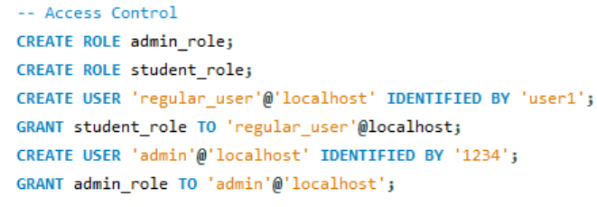
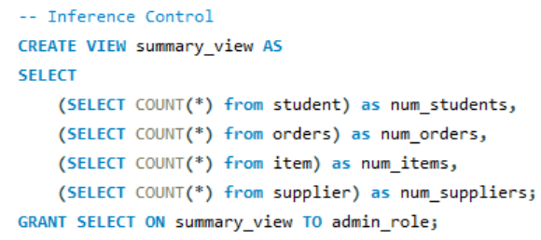
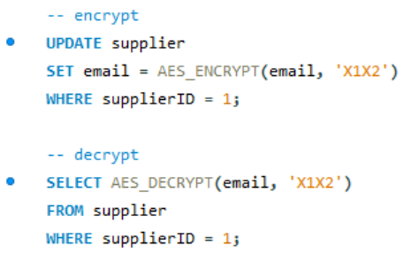
Security Measurements
Access Control
Inference Control
Data Encryption
13

Slide 14
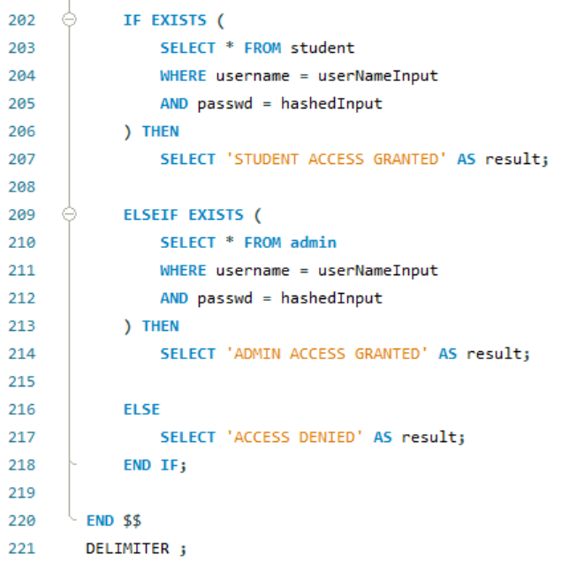
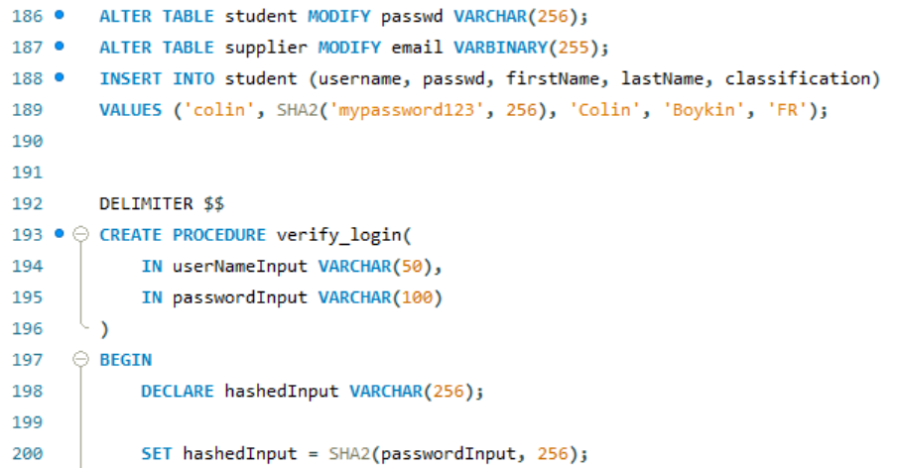
Security Measurements
Flow Control
14

Slide 15
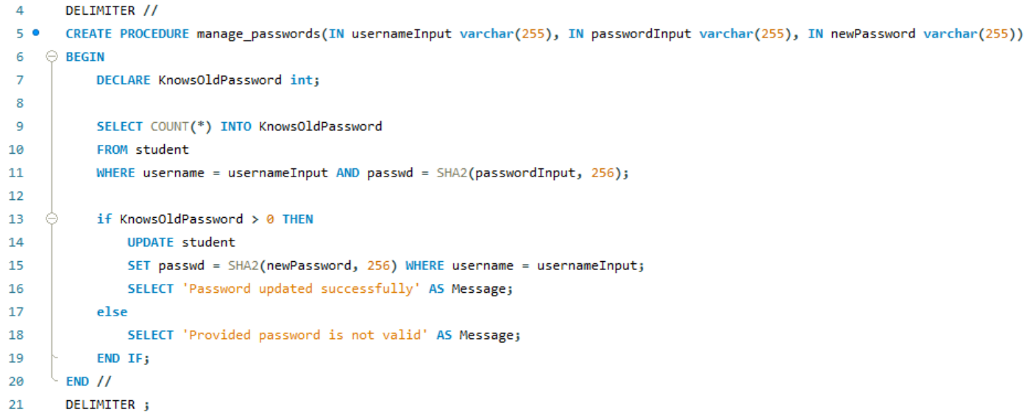
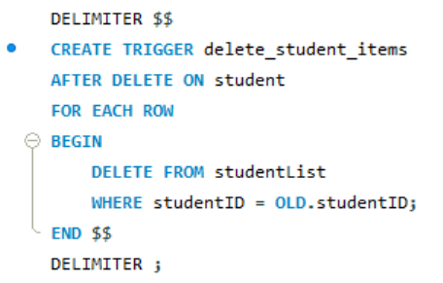
Database Integrity
Stored Procedure: Manage Passwords
Trigger:
Delete Student
15

Slide 16
Demo

Slide 17
Thank
You

Slide 18
References
[1] “W3schools.Com.” W3Schools Online Web Tutorials, www.w3schools.com/sql/sql_datatypes.asp. Accessed 15 Sept. 2025.
[2] “8.3. Character Types.” PostgreSQL Documentation, 14 Aug. 2025, www.postgresql.org/docs/current/datatype-character.html.
[3] “Smith, Rachel. “PostgreSQL Character Types: Char, Varchar, and Text.” Neon, neon.com/postgresql/postgresql-tutorial/postgresql-char-varchar-text. Accessed 15 Sept. 2025.

